Slide 1
PROJECT TITLE Sentiment Analysis of IMDB Movie Dataset
PROJECT ABSTRACT

Slide 2
OBJECTIVE
The objective of this project is to show how sentimental analysis can help improve the user experience over a social network or system interface. The learning algorithm will learn what our emotions are from statistical data then determine the mood. After that it will change our social interactions accordingly on our social network sites or other interfaces like desktop or system services or web-pages. Suppose you are bored or sad ,in the case of social networks one thing the computer could do is to be more suggestive of things that lighten your mood and change interactions like backgrounds color's ,icons services. The site could automatically try suggesting interactions with people and applications that would help improve the mood, while hiding others that might make it worse. The project aims to implement these in the social network community as well as services and interfaces of our systems, while making our lives better and our experience richer and efficient.

Slide 3
Sentiment Analysis Using PYTHON
The purpose of this Sentiment Analysis is:
It is Able to automatically classify a review as a positive or negative sentiment wise as per the customers view on a movie.
The classifier needs to be trained.
We need a list of manually classified reviews on a movie as a movie dataset.

Slide 4
Positive Review Example
I went and saw this movie last night after being coaxed to by a few friends of mine. I'll admit that I was reluctant to see it because from what I knew of Ashton Kutcher he was only able to do comedy. I was wrong. Kutcher played the character of Jake Fischer very well, and Kevin Costner played Ben Randall with such professionalism. The sign of a good movie is that it can toy with our emotions. This one did exactly that. The entire theater (which was sold out) was overcome by laughter during the first half of the movie, and were moved to tears during the second half. While exiting the theater I not only saw many women in tears, but many full grown men as well, trying desperately not to let anyone see them crying. This movie was great, and I suggest that you go see it before you judge.

Slide 5
Negative Review Example
I admit, the great majority of films released before say 1933 are just not for me. Of the dozen or so "major" silents I have viewed, one I loved (The Crowd), and two were very good (The Last Command and City Lights, that latter Chaplin circa 1931).So I was apprehensive about this one, and humor is often difficult to appreciate (uh, enjoy) decades later. I did like the lead actors, but thought little of the film. One intriguing sequence. Early on, the guys are supposed to get "de-loused" and for about three minutes, fully dressed, do some schtick. In the background, perhaps three dozen men pass by, all naked, white and black (WWI ?), and for most, their butts, part or full backside, are shown. Was this an early variation of beefcake courtesy of Howard Hughes?

Slide 6
Classifier
The list of word features need to be extracted from the reviews.
It is a list with every distinct words ordered by frequency of appearance.
To decide which features are more relevant we use Feature Extractor.
The one we are going to use returns a dictionary indicating that words are contained in the input passed.
INPUT – Reviews.

Slide 7
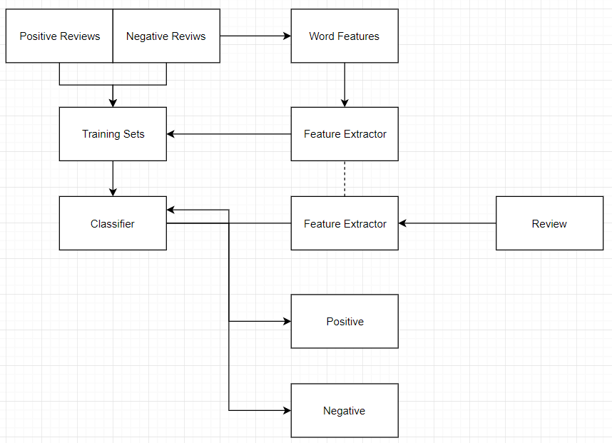
Classifier=nltk.NaiveBayesClassifier.train(training_set)

Slide 8
Navie Bayes Classifier
It uses the prior probability of each label – which is the frequency of each label in the training set and the contribution from each feature.
In our case, the frequency of each label is the same for ‘Positive’ and ‘Negative’.
Word ‘Amazing’ appears in 1 to 5 of the positive reviews and none of the negative reviews.
This means that the likelihood of the ‘positive’ label will be multiplied by 0.2 when this word is seen as part of the input.

Slide 9
Conclusion
The work being done on the topic is vastly narrow and only addresses the issue of USER sentimental analysis and not SNA. Incorporating this will be the next step in achieving better results. Also better incorporation with social Networking sites and other Facilities and supposed android devices can help our program to achieve a more far-reaching experience.

Slide 10
Thank You..!!

